Slide 1

Accelerating Verified-Compiler Development with a Verified Rewriting Engine
Jason Gross, Andres Erbsen, Jade Philipoom, Miraya Poddar-Agrawal, and Adam Chlipala

Slide 2
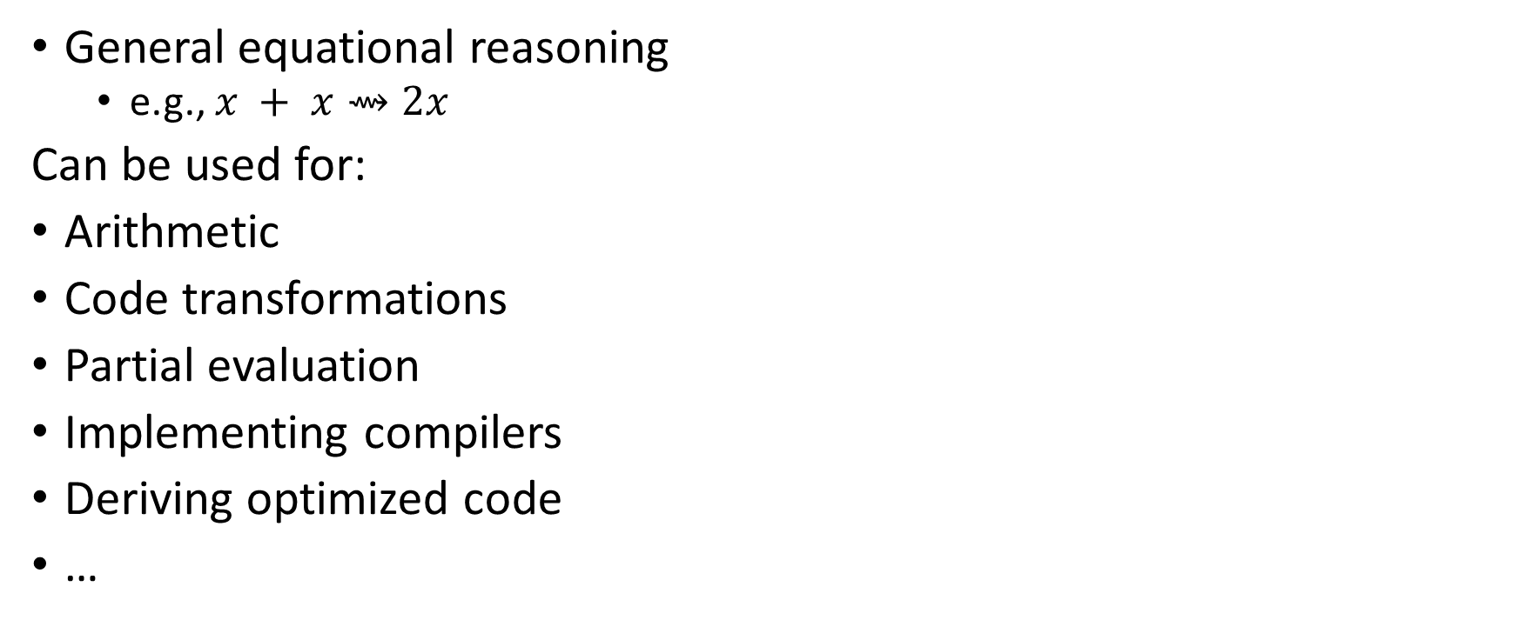
Rewriting: An Essential Proof Engine Component
General equational reasoning
e.g., $x + x⇝2x$
Can be used for:
Arithmetic
Code transformations
Partial evaluation
Implementing compilers
Deriving optimized code
…

Slide 3
Rewriting is Too Slow (for industry-scale applications)

Slide 4






Fiat Cryptography
Industry-scale: generates 100s – 1000s of lines of verified code in Coq
Used in majority of secure connections from web browsers
Firefox Logo from https://www-archive.mozilla.org/foundation/identity-guidelines/firefox
HTTPS image modified from image by Sean MacEntee, CC BY 2.0, via Wikimedia Commons
Chrome logo from https://www.logo.wine/logo/Google_Chrome ©2018 Google LLC All rights reserved. Chrome is a trademark of Google LLC.
Go Logo By The Go Authors - https://blog.golang.org/go-brand, Public Domain, https://commons.wikimedia.org/w/index.php?curid=82371649
File:Logo of WireGuard.svg. (2020, April 21). Wikimedia Commons, the free media repository. Retrieved 23:20, November 28, 2020 from Wikimedia Commons

Slide 5
Partial Evaluation & Rewriting in Fiat Cryptography
64-bit square
static void fiat_25519_carry_square(uint64_t out1[5], const uint64_t arg1[5]) {
uint64_t x1;
uint64_t x2;
uint64_t x3;
uint64_t x4;
uint64_t x5;
uint64_t x6;
uint64_t x7;
uint64_t x8;
fiat_25519_uint128 x9;
fiat_25519_uint128 x10;
fiat_25519_uint128 x11;
fiat_25519_uint128 x12;
fiat_25519_uint128 x13;
fiat_25519_uint128 x14;
fiat_25519_uint128 x15;
fiat_25519_uint128 x16;
fiat_25519_uint128 x17;
fiat_25519_uint128 x18;
fiat_25519_uint128 x19;
fiat_25519_uint128 x20;
fiat_25519_uint128 x21;
fiat_25519_uint128 x22;
fiat_25519_uint128 x23;
fiat_25519_uint128 x24;
uint64_t x25;
uint64_t x26;
fiat_25519_uint128 x27;
fiat_25519_uint128 x28;
fiat_25519_uint128 x29;
fiat_25519_uint128 x30;
fiat_25519_uint128 x31;
uint64_t x32;
uint64_t x33;
fiat_25519_uint128 x34;
uint64_t x35;
uint64_t x36;
fiat_25519_uint128 x37;
uint64_t x38;
uint64_t x39;
fiat_25519_uint128 x40;
uint64_t x41;
uint64_t x42;
uint64_t x43;
uint64_t x44;
uint64_t x45;
uint64_t x46;
uint64_t x47;
fiat_25519_uint1 x48;
uint64_t x49;
uint64_t x50;
x1 = ((arg1[4]) * UINT8_C(0x13));
x2 = (x1 * 0x2);
x3 = ((arg1[4]) * 0x2);
x4 = ((arg1[3]) * UINT8_C(0x13));
x5 = (x4 * 0x2);
x6 = ((arg1[3]) * 0x2);
x7 = ((arg1[2]) * 0x2);
x8 = ((arg1[1]) * 0x2);
x9 = ((fiat_25519_uint128)(arg1[4]) * x1);
x10 = ((fiat_25519_uint128)(arg1[3]) * x2);
x11 = ((fiat_25519_uint128)(arg1[3]) * x4);
x12 = ((fiat_25519_uint128)(arg1[2]) * x2);
x13 = ((fiat_25519_uint128)(arg1[2]) * x5);
x14 = ((fiat_25519_uint128)(arg1[2]) * (arg1[2]));
x15 = ((fiat_25519_uint128)(arg1[1]) * x2);
x16 = ((fiat_25519_uint128)(arg1[1]) * x6);
x17 = ((fiat_25519_uint128)(arg1[1]) * x7);
x18 = ((fiat_25519_uint128)(arg1[1]) * (arg1[1]));
x19 = ((fiat_25519_uint128)(arg1[0]) * x3);
x20 = ((fiat_25519_uint128)(arg1[0]) * x6);
x21 = ((fiat_25519_uint128)(arg1[0]) * x7);
x22 = ((fiat_25519_uint128)(arg1[0]) * x8);
x23 = ((fiat_25519_uint128)(arg1[0]) * (arg1[0]));
x24 = (x23 + (x15 + x13));
x25 = (uint64_t)(x24 >> 51);
x26 = (uint64_t)(x24 & UINT64_C(0x7ffffffffffff));
x27 = (x19 + (x16 + x14));
x28 = (x20 + (x17 + x9));
x29 = (x21 + (x18 + x10));
x30 = (x22 + (x12 + x11));
x31 = (x25 + x30);
x32 = (uint64_t)(x31 >> 51);
x33 = (uint64_t)(x31 & UINT64_C(0x7ffffffffffff));
x34 = (x32 + x29);
x35 = (uint64_t)(x34 >> 51);
x36 = (uint64_t)(x34 & UINT64_C(0x7ffffffffffff));
x37 = (x35 + x28);
x38 = (uint64_t)(x37 >> 51);
x39 = (uint64_t)(x37 & UINT64_C(0x7ffffffffffff));
x40 = (x38 + x27);
x41 = (uint64_t)(x40 >> 51);
x42 = (uint64_t)(x40 & UINT64_C(0x7ffffffffffff));
x43 = (x41 * UINT8_C(0x13));
x44 = (x26 + x43);
x45 = (x44 >> 51);
x46 = (x44 & UINT64_C(0x7ffffffffffff));
x47 = (x45 + x33);
x48 = (fiat_25519_uint1)(x47 >> 51);
x49 = (x47 & UINT64_C(0x7ffffffffffff));
x50 = (x48 + x36);
out1[0] = x46;
out1[1] = x49;
out1[2] = x50;
out1[3] = x39;
out1[4] = x42;
}
Template Code:
Definition mul (p q:list (Z*Z)):list (Z*Z) :=
flat_map (fun '(w, t) =>
map (fun '(w', t') =>
(w * w', t * t’))
q) p.
Fixpoint square (p:list (Z*Z)):list (Z*Z)
:= match p with
| [] => []
| (w, t) :: ts
=> let two_t := 2 * t in
((w * w, t * t)
:: map (λ '(w', t'), (w * w', two_t * t')) ts)
++ square ts
end.
Definition split (s:Z) (p:list(Z*Z)):list (Z*Z) * list (Z*Z)
:= let '(hi, lo) := partition (fun '(w, _) => w mod s =? 0) p in
(lo, map (fun '(w, t) => (w / s, t)) hi).
Definition reduce (s:Z) (c:list (Z*Z)) (p:list (Z*Z)):list (Z*Z)
:= let '(lo, hi) := split s p in lo ++ mul c hi.
Partial Evaluation
32-bit square
static void fiat_25519_carry_square(uint32_t out1[10], const uint32_t arg1[10]) {
uint32_t x1;
uint32_t x2;
uint32_t x3;
uint32_t x4;
uint64_t x5;
uint32_t x6;
uint32_t x7;
uint32_t x8;
uint32_t x9;
uint32_t x10;
uint64_t x11;
uint32_t x12;
uint32_t x13;
uint32_t x14;
uint32_t x15;
uint32_t x16;
uint32_t x17;
uint32_t x18;
uint64_t x19;
uint64_t x20;
uint64_t x21;
uint64_t x22;
uint64_t x23;
uint64_t x24;
uint64_t x25;
uint64_t x26;
uint64_t x27;
uint64_t x28;
uint64_t x29;
uint64_t x30;
uint64_t x31;
uint64_t x32;
uint64_t x33;
uint64_t x34;
uint64_t x35;
uint64_t x36;
uint64_t x37;
uint64_t x38;
uint64_t x39;
uint64_t x40;
uint64_t x41;
uint64_t x42;
uint64_t x43;
uint64_t x44;
uint64_t x45;
uint64_t x46;
uint64_t x47;
uint64_t x48;
uint64_t x49;
uint64_t x50;
uint64_t x51;
uint64_t x52;
uint64_t x53;
uint64_t x54;
uint64_t x55;
uint64_t x56;
uint64_t x57;
uint64_t x58;
uint64_t x59;
uint64_t x60;
uint64_t x61;
uint64_t x62;
uint64_t x63;
uint64_t x64;
uint64_t x65;
uint64_t x66;
uint64_t x67;
uint64_t x68;
uint64_t x69;
uint64_t x70;
uint64_t x71;
uint64_t x72;
uint64_t x73;
uint64_t x74;
uint64_t x75;
uint32_t x76;
uint64_t x77;
uint64_t x78;
uint64_t x79;
uint64_t x80;
uint64_t x81;
uint64_t x82;
uint64_t x83;
uint64_t x84;
uint64_t x85;
uint64_t x86;
uint64_t x87;
uint32_t x88;
uint64_t x89;
uint64_t x90;
uint32_t x91;
uint64_t x92;
uint64_t x93;
uint32_t x94;
uint64_t x95;
uint64_t x96;
uint32_t x97;
uint64_t x98;
uint64_t x99;
uint32_t x100;
uint64_t x101;
uint64_t x102;
uint32_t x103;
uint64_t x104;
uint64_t x105;
uint32_t x106;
uint64_t x107;
uint64_t x108;
uint32_t x109;
uint64_t x110;
uint64_t x111;
uint32_t x112;
uint64_t x113;
uint64_t x114;
uint32_t x115;
uint32_t x116;
uint32_t x117;
fiat_25519_uint1 x118;
uint32_t x119;
uint32_t x120;
x1 = ((arg1[9]) * UINT8_C(0x13));
x2 = (x1 * 0x2);
x3 = ((arg1[9]) * 0x2);
x4 = ((arg1[8]) * UINT8_C(0x13));
x5 = ((uint64_t)x4 * 0x2);
x6 = ((arg1[8]) * 0x2);
x7 = ((arg1[7]) * UINT8_C(0x13));
x8 = (x7 * 0x2);
x9 = ((arg1[7]) * 0x2);
x10 = ((arg1[6]) * UINT8_C(0x13));
x11 = ((uint64_t)x10 * 0x2);
x12 = ((arg1[6]) * 0x2);
x13 = ((arg1[5]) * UINT8_C(0x13));
x14 = ((arg1[5]) * 0x2);
x15 = ((arg1[4]) * 0x2);
x16 = ((arg1[3]) * 0x2);
x17 = ((arg1[2]) * 0x2);
x18 = ((arg1[1]) * 0x2);
x19 = ((uint64_t)(arg1[9]) * (x1 * 0x2));
x20 = ((uint64_t)(arg1[8]) * x2);
x21 = ((uint64_t)(arg1[8]) * x4);
x22 = ((arg1[7]) * ((uint64_t)x2 * 0x2));
x23 = ((arg1[7]) * x5);
x24 = ((uint64_t)(arg1[7]) * (x7 * 0x2));
x25 = ((uint64_t)(arg1[6]) * x2);
x26 = ((arg1[6]) * x5);
x27 = ((uint64_t)(arg1[6]) * x8);
x28 = ((uint64_t)(arg1[6]) * x10);
x29 = ((arg1[5]) * ((uint64_t)x2 * 0x2));
x30 = ((arg1[5]) * x5);
x31 = ((arg1[5]) * ((uint64_t)x8 * 0x2));
x32 = ((arg1[5]) * x11);
x33 = ((uint64_t)(arg1[5]) * (x13 * 0x2));
x34 = ((uint64_t)(arg1[4]) * x2);
x35 = ((arg1[4]) * x5);
x36 = ((uint64_t)(arg1[4]) * x8);
x37 = ((arg1[4]) * x11);
x38 = ((uint64_t)(arg1[4]) * x14);
x39 = ((uint64_t)(arg1[4]) * (arg1[4]));
x40 = ((arg1[3]) * ((uint64_t)x2 * 0x2));
x41 = ((arg1[3]) * x5);
x42 = ((arg1[3]) * ((uint64_t)x8 * 0x2));
x43 = ((uint64_t)(arg1[3]) * x12);
x44 = ((uint64_t)(arg1[3]) * (x14 * 0x2));
x45 = ((uint64_t)(arg1[3]) * x15);
x46 = ((uint64_t)(arg1[3]) * ((arg1[3]) * 0x2));
x47 = ((uint64_t)(arg1[2]) * x2);
x48 = ((arg1[2]) * x5);
x49 = ((uint64_t)(arg1[2]) * x9);
x50 = ((uint64_t)(arg1[2]) * x12);
x51 = ((uint64_t)(arg1[2]) * x14);
x52 = ((uint64_t)(arg1[2]) * x15);
x53 = ((uint64_t)(arg1[2]) * x16);
x54 = ((uint64_t)(arg1[2]) * (arg1[2]));
x55 = ((arg1[1]) * ((uint64_t)x2 * 0x2));
x56 = ((uint64_t)(arg1[1]) * x6);
x57 = ((uint64_t)(arg1[1]) * (x9 * 0x2));
x58 = ((uint64_t)(arg1[1]) * x12);
x59 = ((uint64_t)(arg1[1]) * (x14 * 0x2));
x60 = ((uint64_t)(arg1[1]) * x15);
x61 = ((uint64_t)(arg1[1]) * (x16 * 0x2));
x62 = ((uint64_t)(arg1[1]) * x17);
x63 = ((uint64_t)(arg1[1]) * ((arg1[1]) * 0x2));
x64 = ((uint64_t)(arg1[0]) * x3);
x65 = ((uint64_t)(arg1[0]) * x6);
x66 = ((uint64_t)(arg1[0]) * x9);
x67 = ((uint64_t)(arg1[0]) * x12);
x68 = ((uint64_t)(arg1[0]) * x14);
x69 = ((uint64_t)(arg1[0]) * x15);
x70 = ((uint64_t)(arg1[0]) * x16);
x71 = ((uint64_t)(arg1[0]) * x17);
x72 = ((uint64_t)(arg1[0]) * x18);
x73 = ((uint64_t)(arg1[0]) * (arg1[0]));
x74 = (x73 + (x55 + (x48 + (x42 + (x37 + x33)))));
x75 = (x74 >> 26);
x76 = (uint32_t)(x74 & UINT32_C(0x3ffffff));
x77 = (x64 + (x56 + (x49 + (x43 + x38))));
x78 = (x65 + (x57 + (x50 + (x44 + (x39 + x19)))));
x79 = (x66 + (x58 + (x51 + (x45 + x20))));
x80 = (x67 + (x59 + (x52 + (x46 + (x22 + x21)))));
x81 = (x68 + (x60 + (x53 + (x25 + x23))));
x82 = (x69 + (x61 + (x54 + (x29 + (x26 + x24)))));
x83 = (x70 + (x62 + (x34 + (x30 + x27))));
x84 = (x71 + (x63 + (x40 + (x35 + (x31 + x28)))));
x85 = (x72 + (x47 + (x41 + (x36 + x32))));
x86 = (x75 + x85);
x87 = (x86 >> 25);
x88 = (uint32_t)(x86 & UINT32_C(0x1ffffff));
x89 = (x87 + x84);
x90 = (x89 >> 26);
x91 = (uint32_t)(x89 & UINT32_C(0x3ffffff));
x92 = (x90 + x83);
x93 = (x92 >> 25);
x94 = (uint32_t)(x92 & UINT32_C(0x1ffffff));
x95 = (x93 + x82);
x96 = (x95 >> 26);
x97 = (uint32_t)(x95 & UINT32_C(0x3ffffff));
x98 = (x96 + x81);
x99 = (x98 >> 25);
x100 = (uint32_t)(x98 & UINT32_C(0x1ffffff));
x101 = (x99 + x80);
x102 = (x101 >> 26);
x103 = (uint32_t)(x101 & UINT32_C(0x3ffffff));
x104 = (x102 + x79);
x105 = (x104 >> 25);
x106 = (uint32_t)(x104 & UINT32_C(0x1ffffff));
x107 = (x105 + x78);
x108 = (x107 >> 26);
x109 = (uint32_t)(x107 & UINT32_C(0x3ffffff));
x110 = (x108 + x77);
x111 = (x110 >> 25);
x112 = (uint32_t)(x110 & UINT32_C(0x1ffffff));
x113 = (x111 * UINT8_C(0x13));
x114 = (x76 + x113);
x115 = (uint32_t)(x114 >> 26);
x116 = (uint32_t)(x114 & UINT32_C(0x3ffffff));
x117 = (x115 + x88);
x118 = (fiat_25519_uint1)(x117 >> 25);
x119 = (x117 & UINT32_C(0x1ffffff));
x120 = (x118 + x91);
out1[0] = x116;
out1[1] = x119;
out1[2] = x120;
out1[3] = x94;
out1[4] = x97;
out1[5] = x100;
out1[6] = x103;
out1[7] = x106;
out1[8] = x109;
out1[9] = x112;
}
Partial Evaluation

Slide 6
Rewriting is Too Slow (for industry-scale applications) How Slow is Too Slow?

Slide 7
Fiat Cryptography Pieces
Associational
Columns
Montgomery
Freeze
Bounds Analysis
Positional
Rows
Barrett
Base Conversion
Partial Evaluation

Slide 8
Verification Time: 1 limb
Bounds Analysis
Bounds Analysis
Montgomery
Associational
Montgomery
Associational
Freeze
Freeze
Columns
Columns
Base Conversion
Base Conversion
Rows
Rows
Barrett
Barrett
Partial Evaluation
Positional
Partial Evaluation
Positional

Slide 9
Verification Time: 1 limb
Bounds Analysis
Bounds Analysis
Associational
Montgomery
Freeze
Columns
Montgomery
Base Conversion
Associational
Columns
Freeze
Base Conversion
Rows
Barrett
Rows
Barrett
Partial Evaluation
Positional
Partial Evaluation
Positional

Slide 10
Verification Time: 2 limbs
Bounds Analysis
Associational
Columns
Montgomery
Freeze
Base Conversion
Positional
Rows
Barrett
Partial Evaluation

Slide 11
Verification Time: 3 limbs
Partial Evaluation
Associational
Columns
Montgomery
Freeze
Rows
Base Conversion
Positional
Barrett
Bounds Analysis

Slide 12
Two Options for Solutions
Seek performant modular proof-producing rewriting
Throw away the proof engine and write performant proven-correct rewriting with reflection

Slide 13


Non-Reflection Example
Inductive is_even:ℕ→ℙ := |zero_even : is_even 0 |two_plus_even n : is_even n → is_even (2+n).
Goal is_even 9002.
Goal is:
is_even 9002
repeat constructor
Current Proof is:
two_plus_even 9000
(two_plus_even 8998
(two_plus_even 8996
(two_plus_even 8994 …
Qed
✔
Man Using Laptop by Gan Khoon Lay from NounProject.com CC BY 3.0; Coq logo from https://calebstanford.com/2019/01/15/coq-vector-image/
script by Berkah Icon from the Noun Project; write by royyanandrian from the Noun Project

Slide 14
Reflection Example: Up-Front Work
Inductive is_even:ℕ→ℙ := |zero_even : is_even 0 |two_plus_even n : is_even n → is_even (2+n).
Inductive parity := even | odd.
✔
Definition flip_parity p
:= match p with even => odd | odd => even end.
✔
Fixpoint parity_of (n : nat) : parity :=
match n with
| O => even
| S n' => flip_parity (parity_of n') end.
✔
Lemma parity_of_correct
: ∀ n, parity_of n = even → is_even n.
Proof.
intro n; assert (H' : match parity_of n with
| even => is_even n
| odd => is_even (S n) end).
{ induction n as [|n IH]; cbn; try constructor.
destruct (parity_of n); cbn; try constructor; try assumption. }
intro H; rewrite H in H'; assumption.
Qed.
✔
Man Using Laptop by Gan Khoon Lay from NounProject.com CC BY 3.0; Coq logo from https://calebstanford.com/2019/01/15/coq-vector-image/

Slide 15
Reflection Example
Inductive is_even:ℕ→ℙ := |zero_even : is_even 0 |two_plus_even n : is_even n → is_even (2+n).
Inductive parity := even | odd.
Fixpoint parity_of : ℕ → parity
Lemma parity_of_correct
: ∀ n, parity_of n = even → is_even n.
Goal is_even 9002.
Goal is:
is_even 9002
apply parity_of_correct
Goal is:
parity_of 9002 = even
vm_compute; reflexivity.
Current Proof is:
parity_of_correct 9002 (eq_refl even)
Qed
✔
Man Using Laptop by Gan Khoon Lay from NounProject.com CC BY 3.0
Coq logo from https://calebstanford.com/2019/01/15/coq-vector-image/

Slide 16
Why isn’t there an off-the-shelf solution?
Two Issues:
Reflective solutions are often hard to use
Any given reflective solution can’t handle the full logic

Slide 17
Hard To Use
Want to write:
Hint Rewrite plus_n_O plus_O_n : all.
Goal forall n, 0 + n = n + 0.
intros; autorewrite with all.
In ℛ_{tac}, for example:
Notation "a @ b" :=
(App a b) (at level 30).
Let eq_nat (a b : E) : E
:= Inj (Eq tyNat) @ a @ b.
Let plus (a b : E) : E := Inj Plus @ a @ b.
Let n (n : nat) : E := Inj (N n).
(* forall n, 0 + n = n *)
Definition RW1 : RW typ E subst :=
{| lem := {| Lemma.vars := tyNat :: nil
; Lemma.premises := nil
; Lemma.concl := (tyNat, plus (n 0) (Var 0), Var 0) |}
; side_solver := use_list nil
|}.
(* forall n, n + 0 = n *)
Definition RW2 : RW typ E subst :=
{| lem := {| Lemma.vars := tyNat :: nil
; Lemma.premises := nil
; Lemma.concl := (tyNat, plus (Var 0) (n 0), Var 0) |}
; side_solver := use_list nil
|}.
Let all := fun t => match t with
| tyNat => RW1 :: RW2 :: nil
| _ => nil
end.
Time Eval vm_compute in
let goal := eq_nat (plus (n 0) (Var 0)) (plus (Var 0) (n 0)) in
autorewrite all nil (tyNat :: nil) (@empty _ _ _) nil goal.

Slide 18
Hard Easy To Use
Want to write:
Hint Rewrite plus_n_O plus_O_n : all.
Goal forall n, 0 + n = n + 0.
intros; autorewrite with all.
With our tool:
Make all := Rewriter for (plus_n_O, plus_O_n).
Goal forall n, 0 + n = n + 0.
intros; Rewrite_for all.

Slide 19
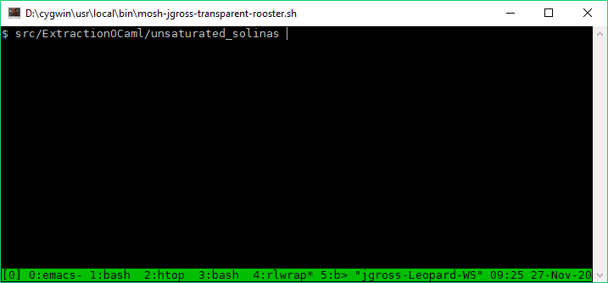

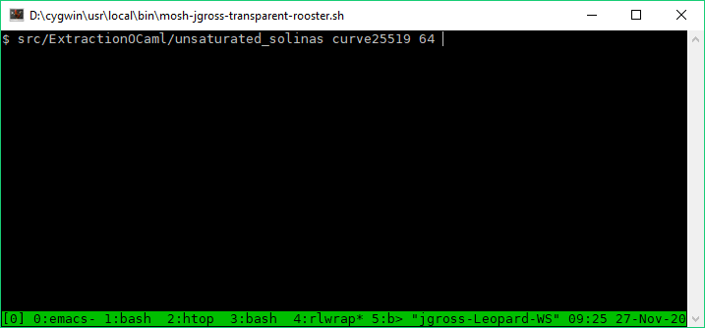


Alternate Usage Mode: Extracted Codegen

Slide 20
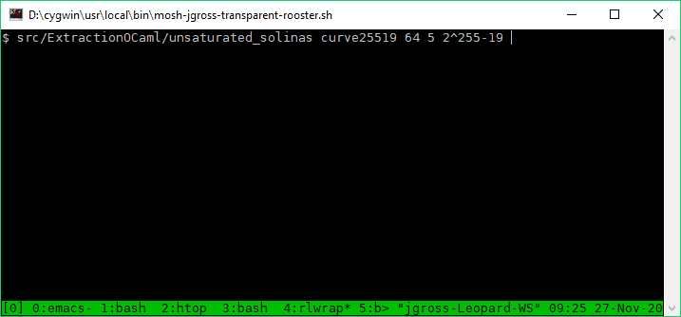
Alternate Usage Mode: Extracted Codegen

Slide 21
Making the Rewriter Usable
Challenges
Expressing the rewrite rules
Reification
Gluing the reflective proof
Solution:
Automate the boilerplate

Slide 22
Why isn’t there an off-the-shelf solution?
Two Issues:
Reflective solutions are often hard to use (solved: automate boilerplate)
Any given reflective solution can’t handle the full logic
Fundamental Obstacle: Gödel’s Incompleteness
We can sidestep this!

Slide 23
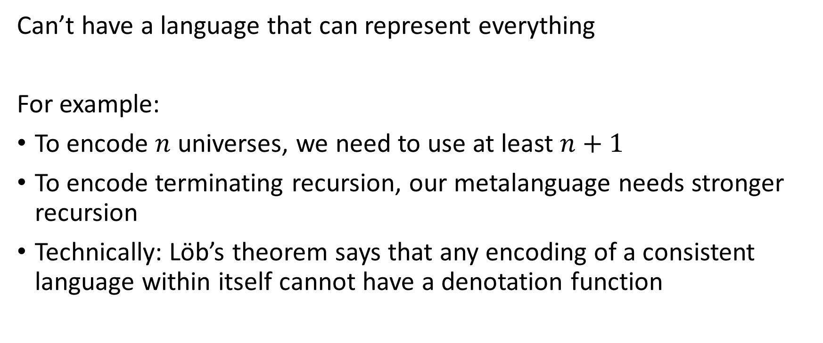
Gödel’s Obstacle
Can’t have a language that can represent everything
For example:
To encode $n$ universes, we need to use at least $n+1$
To encode terminating recursion, our metalanguage needs stronger recursion
Technically: Löb’s theorem says that any encoding of a consistent language within itself cannot have a denotation function

Slide 24
Our Solution
Family of languages
Family of denotation functions
Instantiation is done on-the-fly, automatically, behind-the-scenes

Slide 25
Our Solution
Our family handles:
Any argumentless inductive type
Any non-dependent prenex polymorphic function
Standard: Let binders, Lambdas, Variables, Application
Limitations:
Named eliminators instead of (co)fixpoints
Supported container types: option, list
Limited support for side conditions of rewrite lemmas

Slide 26
Extending Our Solution (Future Work)
Family of languages
Family of denotation functions
Goal:
A family that is broad enough to handle all finite fragments of Coq
Each language in the family would itself require a larger language, still within the family, to encode it
Entire family could be encoded, as a family, using universe polymorphism

Slide 27
Autogenerating Family Instantiations
Inductive base : Type := Bnat.(*non-function types*)
Inductive ident: type base -> Type :=(* constants *)
| iO : ident Bnat
| iS : ident (Bnat -> Bnat)
| iadd : ident (Bnat -> Bnat -> Bnat).
Definition base_interp (ty : type base) : Type.
Definition ident_interp {t} (idc : ident t)
: type.interp base_interp t.
…

Slide 28
Families
Inductive type (base : Type) : Type
:= type_base (t : base) | arrow (s d : type base).
Inductive expr {base ident var}: type base -> Type:=
| Ident {t} (_ : ident t)
| App …
| Abs …
| Var …
| LetIn …
.

Slide 29
Why isn’t there an off-the-shelf solution?
Two Issues:
Reflective solutions are often hard to use
(solved: automate boilerplate)
Any given reflective solution can’t handle the full logic
(solved: use a family instead)

Slide 30
Main Components of our Rewriter
Normalization by Evaluation (NbE) for partial evaluation
Pattern-matching compilation for rewrite-rule selection
Parametric Higher-Order Abstract Syntax (PHOAS)

Slide 31
Normalization by Evaluation
Leverage metalanguage substitution for object-language substitution
Fused with LetIn monad for subterm sharing preservation
Naturally fuses with rewriting

Slide 32
Normalization by Evaluation: Rewrite Ordering
Ordering Rewrites = Ordering Reduction / Computation
(in rewrite-based compiler frameworks / partial evaluation)
asymptotic performance improvement over widely available rewrite orderings
Rewrite Ordering Options:
topdown
bottomup
call-by-value
call-by-name

Slide 33
Pattern-Matching Compilation
Patterns are extracted from rewrite rules
Standard ingredient of programming languages like ML
Adapted to handle rewrite-rule side conditions
Standard algorithm is essentially untyped, which is at tension with well-typed term representations
Leverage efficient case analysis in the metalanguage for efficient case analysis in the object language
Relies on inductive type for constant codes
Avoid string comparisons

Slide 34
Parametric Higher-Order Abstract Syntax (PHOAS)
Well-typed syntax encoding
Avoids binder-bookkeeping
Allows complex transformations involving binders

Slide 35
Performance Evaluation

Slide 36
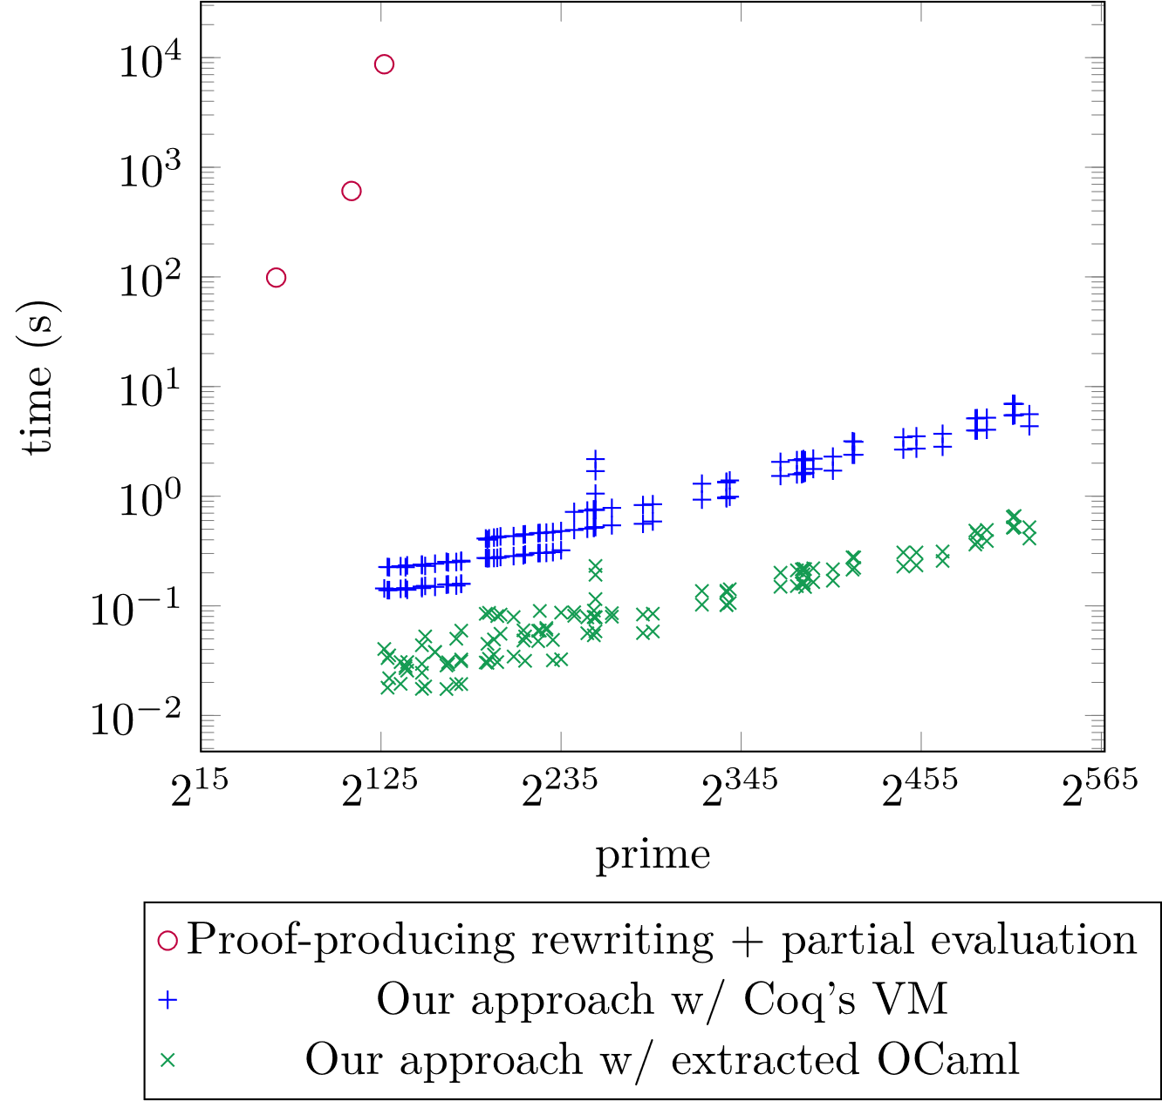
Performance on Fiat Cryptography

Slide 37
Synthetic Performance Benchmark
# binders for:
Curve25519: 90 (x64) or 188 (x32)
P-256: 150 (x64) or 400 (x32)
P-384: 300 (x64) or 916 (x32)

Slide 38

Future Work
Extending this to a complete proven-correct scalable performant rewriting engine for all of Coq without extending the TCB:
Start with MetaCoq / Coq in Coq / Coq Coq Correct!
Parameterize over [map of] named (co)inductives, universes, evars, constants, and eliminators
Adjust well-typedness construction for denotation
Emit necessary instantiations on the fly
(Optional) Add constructor for efficient pattern-matching compilation
Proof Engine Interface:
More support for side conditions
MetaCoq logo from https://metacoq.github.io/

Slide 40
Extra Content

Slide 41
Rewriting Pseudocode: No Binders
rw (f x) =
let (mid, fx_mid) :=
match rw f, rw x with
| (f', f'f), (x', x'x) => (f' x', app_cong f'f x'x)
| _ => (f x, eq_refl (f x))
end in
match rwh mid with
| (result, mid_result) => (result, eq_trans fx_mid mid_result)
| _ => (mid, fx_mid)
end

Slide 42
Rewriting Pseudocode: With Binders
rw (fun x:T => e) =
let rrw := (fun x:T => rw e) in
let mid := (fun y:T => let (e', _) := beta (rrw y) in e') in
let f_mid := functional_extensionality
(fun z:T => let (_, e'e) := beta (rrw z) in e'e) in
match rwh mid with
| (result, mid_result) => (result, eq_trans f_mid mid_result)
| _ => (mid, f_mid)
end

